Slide 1



ASSET MANAGEMENT STRATEGY
STREATEGIC AND SPECIFIC GOALS AND MEASURES
04.12.2020.
Support to the development of an Asset Management System and Asset Information System in the Railway Sector, Montenegro
Contract# EIB-MNE-RIOM-SER-SL-2019-A1

Slide 2

AGENDA
  Introduction and methodological basis 14:00-14:15
  Presentation of Strategic and Specific Goals within Asset Management Strategy 14:15-15:00
  Break 15:00-15:15
  Discussion on the proposed goals and measures - conclusions to be implemented in the Asset Management Strategy 15:15-15:45
  Discussion regarding the Asset Management System 15:45-16:15
  Further steps in Project Implementation 16:15-16:30

Slide 3
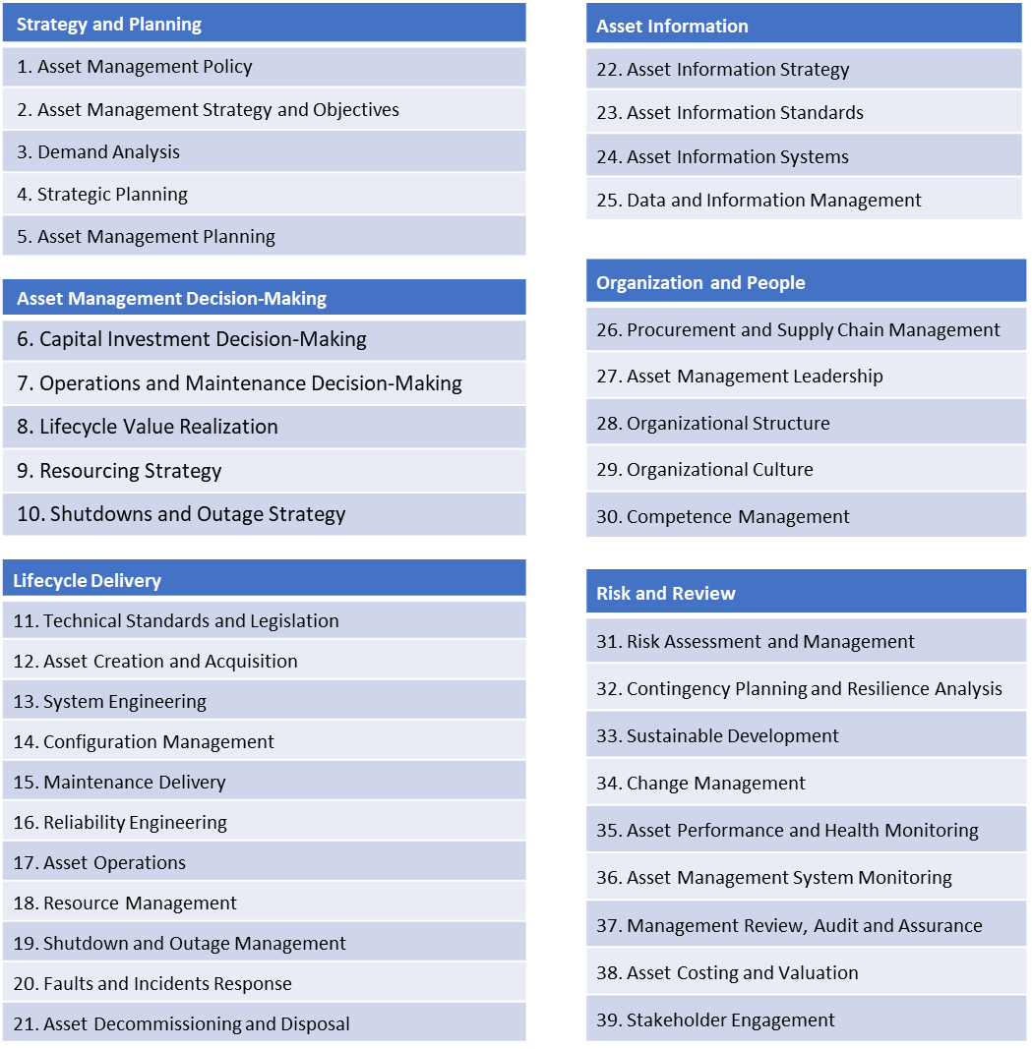
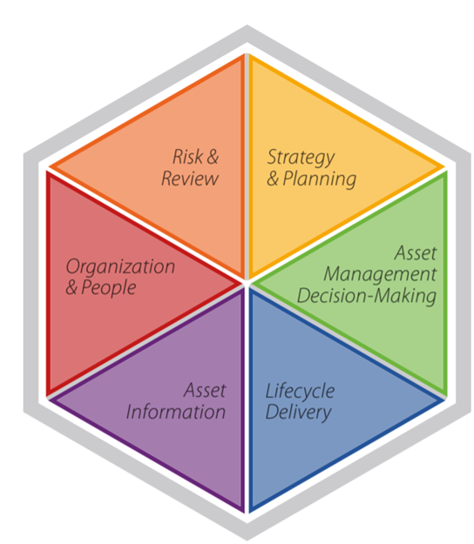
GAP Analysis Methodological Basis - reminder
ISO 55001+BSI PAS 55 (British Standards Institution’s Publicly Available Specification)+International Infrastructure Management Manual (IIMM) = AMEM (Asset Management Excellence Model)

Slide 4
Maturity Scales in the process of Asset Management - reminder

Slide 5
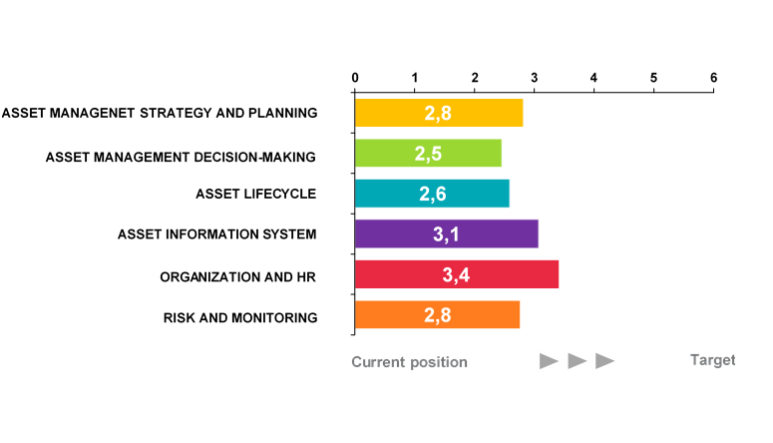
Key Findings per groups of subjects within Asset Management

Slide 6
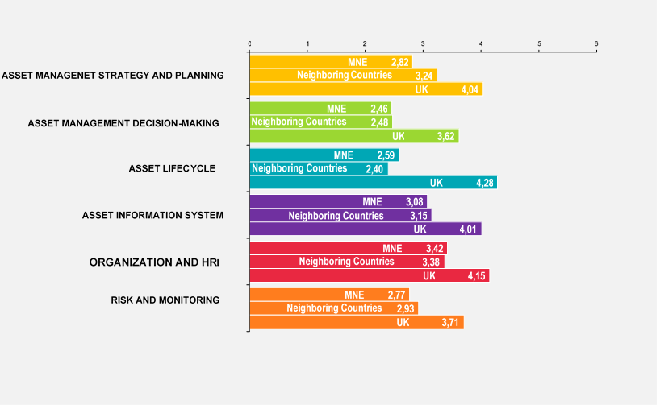
…comparison with the region and the UK

Slide 7


Strategic priorities, specific objectives, and measures

Slide 8
Strategic priorities, specific objectives, and measures hierarchy

Slide 9
Strategic priority 1: Development of railway infrastructure as an integral part of the trans-European transport network
Strategic Priority 1 arises from the Strategy for Railway Development from 2017-2027 and was defined in that document as Objective 8
To meet the stated strategic priority, the Railway Infrastructure of Montenegro should achieve two goals, which relate to:
SO 1.1. To ensure compliance with regulatory requirements
SO 1.2. To provide sustainable service to the customers

Slide 10
Specific objective 1.1.
To ensure compliance with regulatory requirements
To achieve stated objective the Company should ensure compliance with the regulatory requirement of the Montenegro as well as to implement the goals defined by the Strategy for Railway Development from 2017-2027.
In order to meet the stated objective, the Company should undertake the following measures:
M 1.1.1. Implementation of the system for planning the modernization of fixed assets
M 1.1.2. Adaptation of the supply system

Slide 11
Specific objective 1.2.
To provide sustainable service to the customers
In the process of analyzing the expected demand for services, one should also keep in mind the conclusions stated in the report prepared by the consortium led by Connect, which draws special attention to the volume of transport in the region in the context of accession of the Western Balkans countries to the EU.
M 1.2.1. To provide its clients with the appropriate service, the Company should have an adequately trained workforce.

Slide 12
Strategic priority 2: The highest standard of efficiency
To meet the stated strategic priority, the Railway Infrastructure of Montenegro should achieve four goals, which relate to:
SO 2.1. Optimize the asset management system
SO 2.2. Improve the system and the processes for asset information
SO 2.3. Improve risk control and monitoring of asset management systems
SO 2.4 Improve the organization and strengthen human resources for asset management

Slide 13
Specific objective 2.1.
Optimize the asset management system
The asset management process relies on the domestic regulatory framework (Law on Railways and Law on Railway Safety) and on international asset management standards - ISO 55001 standard and Publicly Available Specification 55 of the British Standardization Institution (BSI PAS 55), which are operationalized through the International Handbook on Infrastructure Management (IIMM)
Required measures to meet the stated objective:
M 2.1.1. Adoption of Asset Management Strategy and improvement of Asset Management Planning
M 2.1.2. Improvement of Decision-Making Process related to Asset Management

Slide 14
Specific objective 2.2.
Improve the system and the processes for asset information
Good asset management requires quality, timely asset information and asset management
The required standards for asset data are partly defined by the Law
In order to meet the stated objective, the Company should undertake the following measures:
M 2.2.1. Development of a modern and intelligent asset information system
M 2.2.2. Improvement of data and information management process

Slide 15
Specific objective 2.3.
Improve risk control and monitoring of asset management systems
The area of risk management is set as a legal obligation
The Company should develop a risk management framework, gain experience in its application, and identify those risks that may have the greatest impact on assets and operations
Required measures to meet the stated objective:
M 2.3.1. Development of a risk management framework and improving competencies for the identification of key risks to assets and operations to increase the resilience to crisis
M 2.3.2. Ensure sustainable development and reduce environmental impact

Slide 16
Specific objective 2.4.
Improve the organization and strengthen human resources for asset management
The issue of individual competencies of persons involved in the asset management process is conditioned by legal regulations, strategic goals, and certainly by the organizational culture and attitude of employees
Required measures to meet the stated objective:
M 2.4.1. Design a clear and effective process for managing and assigning tasks and responsibilities for asset management
M 2.4.2. Improve the competencies of employees and ensure the achievement of minimum legal requirements on the competencies of railway workers

Slide 17
Strategic priority 3: Continuous improvement of the quality of railway service
Improved railway service and modern infrastructure should be achieved by new technologies and by introduction of multimodal transport services
Related objectives to strategic priority No. 3 are:
SO 3.1. Achieve a high level of reliability
SO 3.2. Achieving and maintaining a high level of safety
SO 3.3. Achieving and maintaining high speeds

Slide 18
Specific objective 3.1.
Achieve a high level of reliability
The infrastructure must meet Law defined technical requirements
In order to meet the stated objective, the Company should improve and streamline processes during the period of use of the assets
M 3.1.1. This mean that the Company should establish a process of measuring the success of procurement through the analysis of planned/realized procurement costs and to work on the introduction of reliability indicators, also envisaged by the Railway Transport Development Strategy

Slide 19
Specific objective 3.2.
Achieving and maintaining a high level of safety
Safety requirements are defined by national legislation and it is also strategic objective no 3 within Traffic Development Strategy of Montenegro
The Law on Railway Safety sets a requirement for the establishment of a Safety Management System
Required measures to meet the stated objective:
M 3.2.1. Modernization of the assets of road crossings
M 3.2.2. Modern systems for railway infrastructure maintenance

Slide 20
Specific objective 3.3.
Achieve and maintain high speeds
Increasing the average speed of trains would enable certain regions in Montenegro to maximize their development and economic potentials, primarily tourism and agriculture
M 3.3.1. The main measure to achieve stated objective is introduction of investment planning system
This approach is also aligned with “soft measure” - Establishment of functioning maintenance system ensuring no section in poor/very poor condition by 2020 which was defined through the agreement by the WB Prime Ministers in Vienna (August 2015)

Slide 21
Strategic priority 4: Limiting the impact of rail transport on the environment
According to Law in Montenegro the Infrastructure Manager should take care of the environment when performing the activity
To meet the stated strategic priority, the Railway Infrastructure of Montenegro should achieve three goals, which relate to:
SO 4.1. To promote green building design and construction
SO 4.2. To reduce energy consumption
SO 4.3. To reduce carbon

Slide 22
Specific objective 4.1.
To promote green building design and construction
Railway is environmentally more acceptable than for example road transport and that is why it should offer possibilities to the railway to become a more competitive means of transport
In all phases and activities related to the railway transport the Company should apply the highest environmental protection standards
M 4.1.1. With the technological development during the last couple of decades, the use of appropriate materials from the perspective of environment protection become affordable even for railway sector

Slide 23
Specific objective 4.2.
To reduce energy consumption
M 4.2.1. It is expected the railway Podgorica – Nikšić to generate positive environmental impacts by passing of larger number of passengers from road to railway type of transport and thus become an example of possible efficiency of railway in this domain

Slide 24
Specific objective 4.3.
To reduce carbon
Electricity and fuel used for traction and maneuvering are the main forms of energy used in rail transport. With a fleet that is not completely modernized, the annual energy consumption in ZPCG is about 60,000 oil and about 15 million kWh of electricity
M 4.3.1. With further modernization of vehicles, and the application of innovative technologies, the transport companies will be able to use and very efficiently convert energy resources into towing and transportation services

Slide 25
Strategic priority 5: Increasing the competitiveness of rail transport
Strategic objective no. 6 within Strategy for Railway Development 2017-2027
Modern infrastructure is functional and adjusted to the demands of its users, meaning quality and efficient service
Efficient and competitive Company that is capable of fighting in local and regional markets
Main strategic objectives within this objective is:
SO 5.1. To equip with appropriate technology and maintenance of the asset
SO 5.2. To link asset (infrastructure) investment decisions to service outcomes

Slide 26
Specific objective 5.1.
Equip with appropriate technology and maintenance of the asset
The Company should establish, implement and maintain processes and / or a process for monitoring and measuring the performance of the asset management system
M 5.1.1. This objective should be fulfilled by bearing in mind that it is required to level the technological level with main competitors of the Company

Slide 27
Specific objective 5.2.
Link asset (infrastructure) investment decisions to service outcomes
In order to do so, service outcomes have to be precisely defined in the participative approach with all relevant stakeholders.
Additional sphere for evaluation of provided services is against the total and optimal capacity of usage of railway infrastructure.
This track record has to have time dimension in order to see whether the Company increase or decreased its competitiveness.
M 5.2.1. Company has to monitor the quality and quantity of provided services, not just against its own business plans, but also to compare it with their competitors (direct and indirect)

Slide 28
Asset Management GAP Analysis
Thank you for your attention
07.10.2020.
Support to the development of an Asset Management System and Asset Information System in the railway sector, Montenegro
Contract# EIB-MNE-RIOM-SER-SL-2019-A1

